Slide 1
Data Privacy, GDPR Laws
Prepared by: Mohammed Sayeeduddin

Slide 2
Data Privacy:
Data Privacy is crucial in protecting individuals' personal information from unauthorized access, misuse, and exploitation. It involves implementing measures to ensure that personal data is collected, stored, processed, and shared securely and in compliance with legal and regulatory requirements. The importance of data privacy can be summarized in the following points
Protects Individuals' Rights
Prevents Identity Theft and Fraud
Builds Trust
Compliance with Laws and Regulations

Slide 3
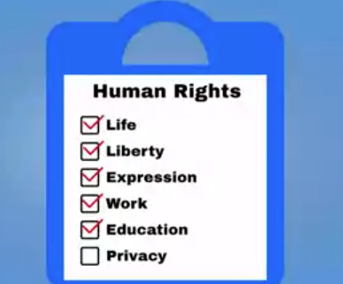

Slide 4
GDPR Laws (General Data Protection Regulation
What is GDPR?
GDPR Laws (General Data Protection Regulation) are a set of regulations enacted by the European Union to protect the privacy and personal data of EU citizens. GDPR mandates strict guidelines on data collection, storage, processing, and sharing, requiring organizations to obtain explicit consent from individuals and to provide mechanisms for data access, correction, and deletion.
Use Case: A multinational company must comply with GDPR by updating its data handling policies, implementing robust data protection measures, and ensuring that customer data is processed with explicit consent.

Slide 5
Reason:
Standardized Privacy Protection
Uphold privacy protection

Slide 6
GDPR Deals with
control over their data
who processes their data
what their data is used for

Slide 7
GDPR Principles
Lawfulness, Fairness, and Transparency: Personal data must be processed legally, fairly, and in a transparent manner. Organizations must inform individuals about how their data is being used.
Purpose Limitation: Data must be collected for specified, explicit, and legitimate purposes and not further processed in a manner that is incompatible with those purposes.
Data Minimization: Only the necessary data for the intended purposes should be collected and processed.
Accuracy: Personal data must be accurate and kept up to date. Inaccurate data should be corrected or deleted without delay.

Slide 8
Storage Limitation: Data should be stored only as long as necessary for the purposes for which it was collected.
Integrity and Confidentiality: Data must be processed in a manner that ensures appropriate security, including protection against unauthorized or unlawful processing, accidental loss, destruction, or damage.
Accountability: Organizations are responsible for complying with these principles and must be able to demonstrate their compliance.

Slide 9
Important Terminology
Personal Data:
Any information that relates to an identified or identifiable individuals.
It can be one item or a collection of items that, together can identify an individual
it include:
Name
Address
Government identification number
Email address
IP address
Geo address/Location

Slide 10
indirect collection (Special categories of Personal data)
1.Race
2.Gender
3.Ethnicity
4.Political
5.Religious
6.Phillospical believes
7.Idealogy
8.Health information
9.Bio metric information
10.Union membership
11.Human resources file

Slide 11
Quiz
Scenario: An author has a membership with a local club. The name he uses for his account is actually his pseudonym. When a roster of club members' names is accidentally published on the club's site, the author files a complaint for a privacy violation. However, the club's manager tells him his complaint has no grounds because no actual personal data was leaked. Is this accurate?
a)No
b)Yes

Slide 12
Answer
Correct! A pseudonym is considered Personal Data and is protected under GDPR law. Other types of Personal Data include other identifiers like names, physical addresses, email addresses, government ID numbers, and more.

Slide 13
data subject
Any individuals whos data is collected and
whose privacy rights under the protection of GDPR

Slide 14
3.Data controller:
determines how they will store,process, use, transfer and destroy the data
1.Retailers
2.Service providers
3.Health entities
4.help desk services
5.employers

Slide 15
4.data processers
Natural person or legal person 3rd party data processing companies

Slide 16
5.Data protection Authroty (DPA)
A DPA is an independent national public authority that protects its citizens and residents fundamental privacy rights. Essentially, they are the governing bodies of GDPR. Each EU member state has at least one DPA. Some examples include the German Federal Commissioner for Data Protection and the Croatian Personal Data Protection Agency.

Slide 17
6.Data protection office (DPO)
Data Protection Officer. A DPO is a GDPR expert who ensures their organization is GDPR compliant. It's always a good idea to have a DPO on staff. In some cases, it is required. Now that that's covered

Slide 18
Rights of the Data Subjects

Slide 19
Quiz
GDPR stands for _ _ _ _.
General Data Privacy Restrictions
General Directives for Privacy Regulation
General Data Protection Regulation
General Data Protection Rules

Slide 20
Scenario: Hemal is a customer service representative working out of a call center in India. Her employer is based in the EU, as are many of their customers. In between taking calls, her coworker informs her that because their call center is based outside of the EU, the regulations of GDPR do not impact them. Is this accurate?
No, it is not accurate because GDPR applies to everyone, everywhere
Yes, it is accurate
No, it is not accurate because the employer is based in the EU and so are the customers

Slide 21
Answer for 2nd quiz
No, it is not accurate because the employer is based in the EU and so are the customers
Correct! GDPR applies to EU organizations. More importantly, the law follows the data subject, meaning wherever their data goes, it must be protected. Even if it ventures outside of the EU!

Slide 22
Quiz 3
Scenario: Chester and Sofia tied the knot today! In the months leading up to the wedding, they collected a roster of contact information for wedding guests, including email addresses, names, and addresses. Many guests are residents of the EU. Are the bride and groom subject to GDPR law for the personal data they have collected?
Yes
No

Slide 23
Answer
No.
Correct! GDPR does not apply in instances of personal or household activity. The newlyweds can ride off into the sunset without a thought to GDPR.

